Slide 1
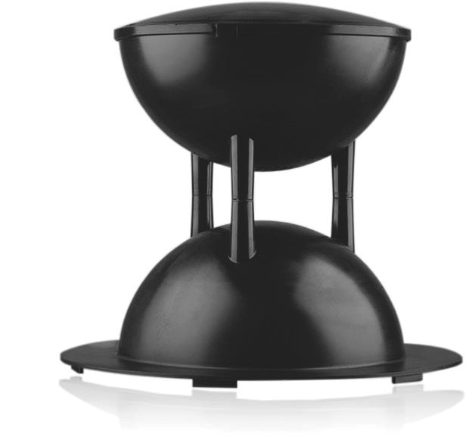
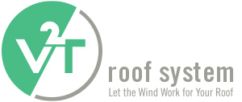

Slide 2
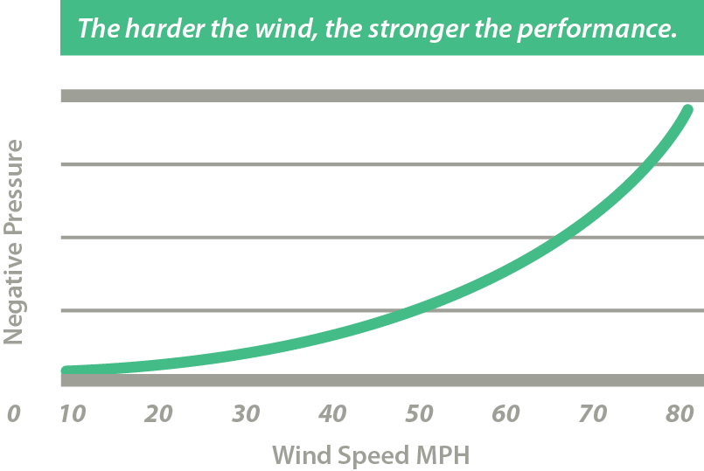
What is the V2T Roof System?
The V2T Roof System uses the power of the wind to hold the roof securely in place. The technology behind this patented system uses a recognized principle of physics to create a vacuum that becomes stronger as the speed of the wind increases. The vacuum pulls the air from under the membrane - drawing it down to the deck and holding the membrane firmly in place. In this way, destructive uplift pressures are counteracted by a greater vacuum force created by the vent. The harder the wind blows the better the vent works.
With V2T, the harder the wind, the stronger the grip!
V2T has been tested at a NASA facility at the Langley Air Force Base, the Insurance Institute for Business & Home Safety (IBHS) and the Underwriters Laboratory (UL Test), among others, and has been tested to withstand wind speeds of up to 150 MPH.

Slide 4
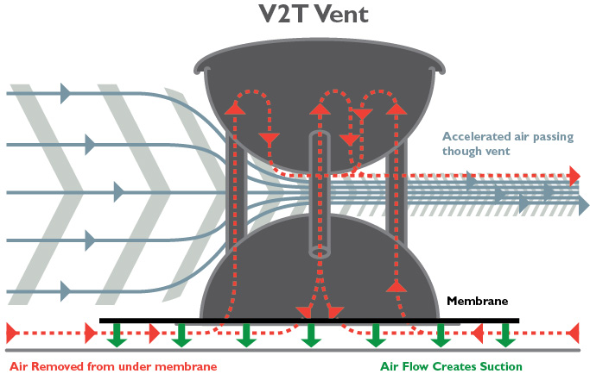
V2T Vent How does it work?
The V2T Roof System utilizes a carefully placed series of “vents” which force the wind to create a vacuum that holds the membrane to the substrate without the need for large amounts of ballast, adhesives, or other fasteners. The harder the wind blows across the low slope roof, the harder the “vent” is working on keeping the membrane “glued” to the roof floor.

Slide 5
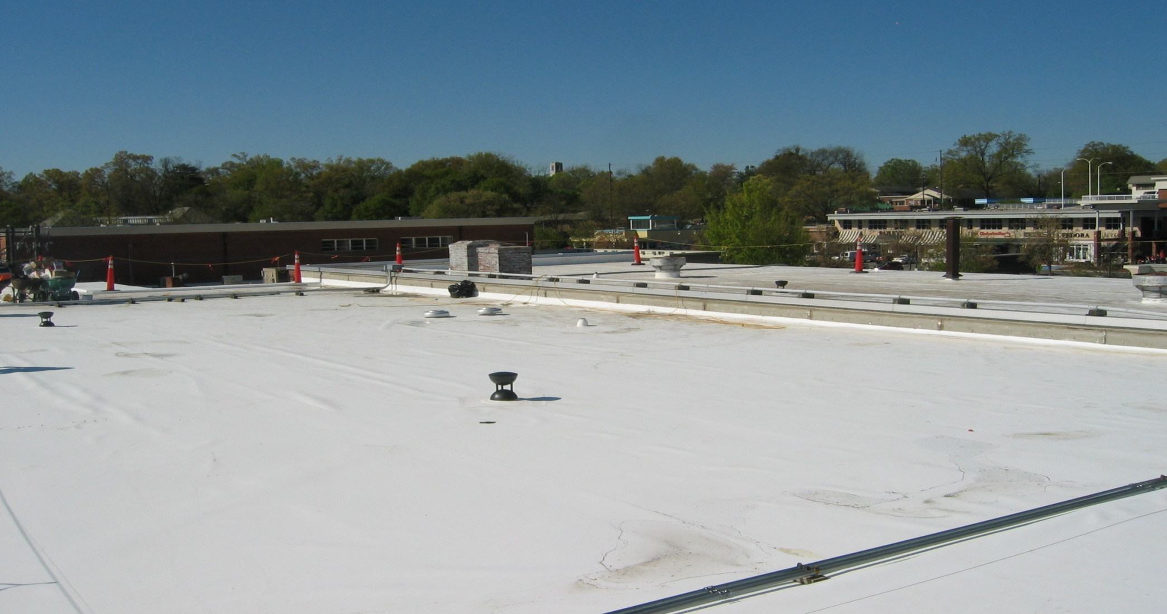
A Test by Mother Nature
The science works so well that the main section of this installation remained in place even as tornados tore off all of the metal and some sections of this roof in the summer of 2011. An amazing tribute to the power of the vent!

Slide 6
V2T - Monitoring Technology
Developed in conjunction with Boeing under a prestigious award from the Space Alliance Technology Outreach Program (SATOP), the V2T Roof System utilizes a space sensor technology to monitor and measure:
The drying effect of the V2T system
Moisture levels within the membrane
Pressure levels on the roof
When and where you have a potential leak or other compromise in your roof.
A sensor located inside the upper hemisphere of the vent transmits readings wirelessly to the data acquisition hub housed inside the building. The data is analyzed and can provide roof owners, consultants, or your contractor with relevant moisture and pressure reports, keeping your roof in the best shape possible.

Slide 7
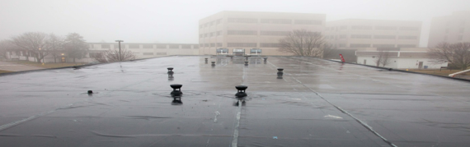
Types of Applications
The V2T Roof System is a highly versatile roof system that works on:
Concrete decks
(structural & lightweight)
Gypsum decks
Existing roof recovery
Pre-engineered metal roof
Metal decks
Commercial flat roofs
New construction
Reroofs
Virtually any sealed deck is an opportunity for a V2T Roof System

Slide 8
Benefits of V2T Roof Systems
20 year warranty with leading membrane manufacturers | A V2T Roof System lasts longer than a traditional applied roof
Highly competitive in price and technology | Work is completed faster
Does not have cold weather limitations for installation, unlike fully adhered systems | Less destruction in and around the building
Green technology – Old membranes can be fully recycled, no landfill waste, less VOC’s, less toxic adhesives | V2T Roofs will keep the building and insulation dry
Each V2T Vent replaces 7 buckets adhesive; 1000 screws; or 24,000 lbs. of ballast | Application inspection 2x a year with full report (roof system is only sold with a service agreement)
Applicable for both new construction & retrofit | Competitive pricing for a better, stronger & safer roof

Slide 9
V2T for Your Roof
Whether new construction or repair, concrete or metal, virtually any sealed deck is an opportunity to leverage the V2T system for a longer lasting, more efficient, and lower cost solution.
Because the V2T Roof System leverages the power of the wind for strength, rather than fighting against the wind, it holds better, for longer, and does so without the need for ballast, adhesive and screws. This means:
  A much quicker install
  Reduced exposure to weather during construction
  Easier repairs and maintenance (you can simply cut it loose and reuse insulation
  Lower total cost over the life of the roof
The V2T roof System actually pulls moisture out from under the membrane reducing the risk of leaks and allowing for installation even if the substrate is moderately moist. Moreover, it comes with a monitoring system that actually reports where moisture may be occurring, thus allowing roofers to target problem areas quickly and efficiently.

Slide 10
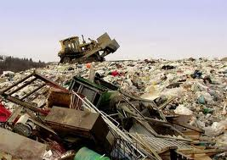
Go Green!
Old membranes can be fully recycled,
No landfill waste
Less VOC’s
Less adhesives i.e. less toxic waste
Longer lasting roofs
Less stress on membranes
It’s loose laid
On 160 Million tons of construction waste per year,
25% comes from roofing which equals to
40 Million Tons….to be precise

Slide 11
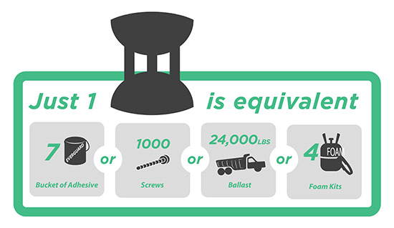

Slide 12
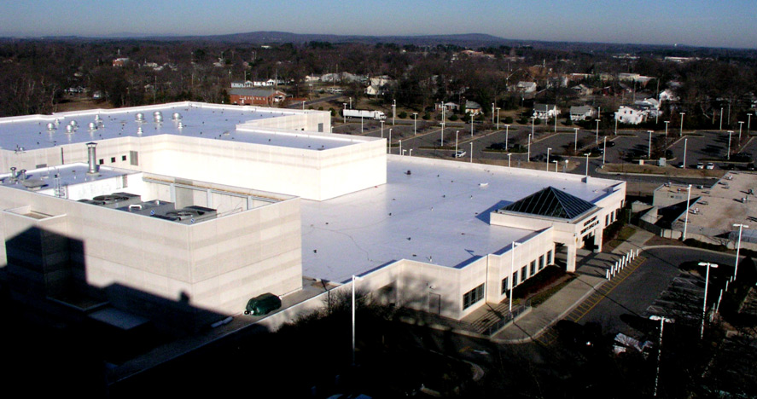
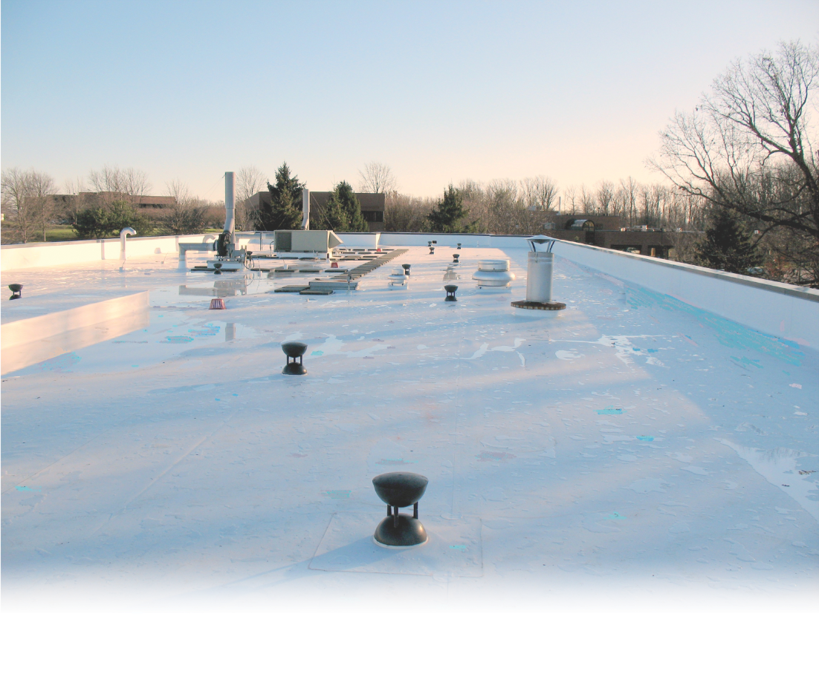
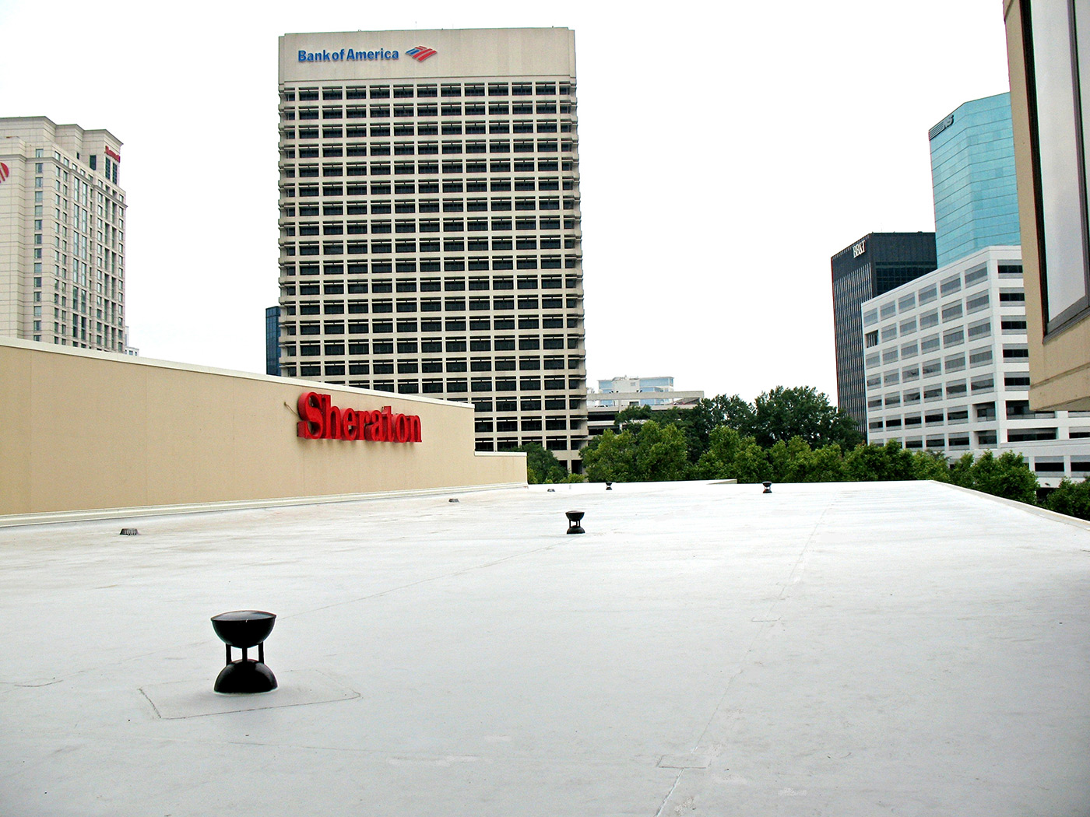
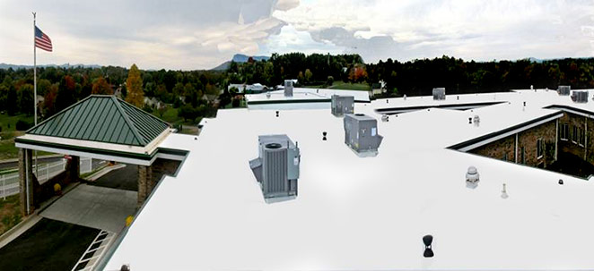
Feature Projects
Gaston County Public Works
Virginia Tech
Sheraton Waterside Norfolk
Highland Ridge Nursing Facility

Slide 13

Contact Us
The V2T Roof System installs faster, cleaner, safer, requires no additional equipment, uses the same top quality membranes (with the same warranties) as any other top system, and in less than ideal weather compared to traditional roofs.
Only V2T Approved Applicators can install the V2T Roof System.
Call us today to learn more!
Add consultant/contractor contact info here

